Slide 1

Lip Reading using Deep Learning Techniques
Ruchir Powar(21106036)
Mansi Ghanwat(21106028)
Jayesh Patil(21106048)
Maviya Bubere(21106022)
Project Guide
Ms.Vijaya Bharathi

Slide 2
Outline
Introduction
Literature Survey of the Existing Systems
Limitations of the Existing Systems
Problem Statement
Proposed System Design
Framework/Algorithm
Technologies Stack for Proposed System
Input to the System
Implementation(Partial)
Conclusion
References

Slide 3
Introduction
The aim of lip reading is to accurately interpret spoken words from visual lip movements to enhance communication and transcription capabilities.
Visualize and interpret spoken words through lip movements, addressing challenges like homophemes.
Utilizes advanced neural networks and large datasets for accurate sentence-level lipreading.
Enhances communication in noisy environments and aids in transcription and security applications.
Demonstrates high accuracy on benchmark datasets and provides insights through visualizations of model behavior.

Slide 4
Limitations of Existing Systems
Context Dependency: Lip reading often requires contextual information to resolve ambiguities from similar lip movements.
Visual Ambiguity: Difficulty in distinguishing between phonemes that produce similar visual patterns.
Environmental Factors: Performance can be affected by varying lighting, angles, and speaker's facial expressions.
Data Constraints: Limited availability of diverse and high-quality datasets for training robust models.

Slide 5
Problem statement
Speech recognition systems have traditionally relied on audio signals to convert spoken language into text. However, in noisy environments or situations where audio signals are unavailable, these systems face significant challenges in accurately interpreting speech.
This limitation can adversely affect communication technologies, especially in critical applications like voice-activated systems, assistive devices for the hearing impaired, and security systems.
Lip reading, which involves analyzing the visual movements of a speaker's lips, offers a potential solution to these challenges by providing an alternative method to interpret speech.

Slide 6
Literature Survey of the existing system
Title | Authors | Description
1. Lipnet: End-to-End sentence-level lipreading(arXiv 2016) | YANNIS M. ASSAEL,BRENDAN SHILLINGOFRD1 , SHIMON WHITESON & NANDO DE FREITAS | LipNet is an end-to-end deep learning model for sentence-level lipreading, designed to transcribe spoken language from video sequences of lip movements. It eliminates the need for traditional phoneme-level alignment, directly mapping visual inputs to text for seamless visual speech recognition.
2. Deep Learning-Based Automated Lip-Reading: A Survey(IEEE 2021) | SOUHEIL FENGHOUR, DAQING CHEN, KUN GUO, BO LI & PERRY XIAO | This survey explores the advancements in deep learning techniques for automated lip-reading, summarizing the latest methodologies and their applications. It provides a comprehensive overview of how these technologies enhance visual speech recognition and their impact on various domains.
3. A Lip Reading Method Based on 3D Convolutional Vision Transformer(IEEE 2022) | HUIJUAN WANG , GANGQIANG PU, AND TINGYU CHEN | This method utilizes a 3D Convolutional Vision Transformer to improve lip-reading accuracy by capturing and interpreting spatial and temporal features from video sequences. It advances visual speech recognition by integrating deep learning techniques with 3D spatial analysis.

Slide 7
Literature Survey of the existing system
Title | Authors | Description
1. LipSyncNet: A Novel Deep Learning Approach for Visual Speech Recognition in Audio-Challenged Situations.(IEEE 2024) | S. A. AMUTHA JEEVAKUMARI, AND KOUSHIK DEY | LipSyncNet is an advanced deep learning model designed for visual speech recognition, specifically optimized for scenarios with poor audio quality. It leverages lip movement analysis to accurately transcribe spoken words, enhancing communication in audio-challenged environments.
5. Lip Reading Sentences in the Wild(IEEE 2017) | SON CHUNG, JOON, ANDREW SENIOR, ORIOL VINYALS, AND ANDREW ZISSERMAN. | "Lip Reading Sentences in the Wild" focuses on developing models capable of accurately interpreting spoken sentences from lip movements in diverse, real-world conditions. This approach aims to enhance lipreading performance by addressing the variability and complexity of natural environments.

Slide 8
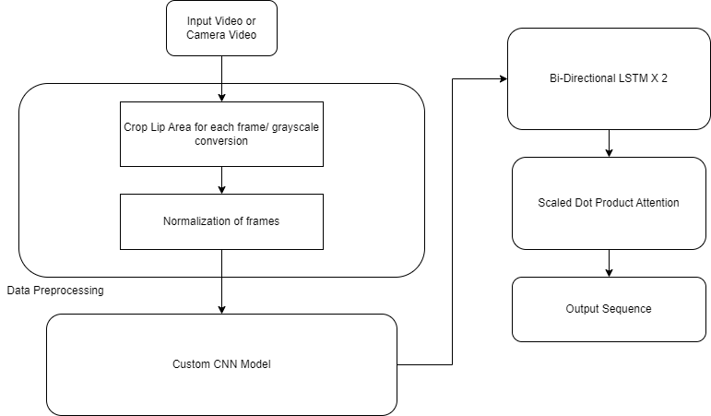
Proposed System Design

Slide 9
Framework/Algorithm
3D Convolutional Neural Networks(3DCNN): Used to extract spatio temporal features efficiently compared to traditional Neural Networks.
Bi-Directiional Long Short Term Memory(Bi-LSTM): Used to predict sequence from features extracted. It is a type of Recurrent Neural Network (RNN) that's designed to process and retain information over multiple time steps.
Attention Mechanism: Used to focus on relevant information to accurately predict the next sequence element. It allows models to selectively attend to different parts of the input data, assigning varying degrees of importance or weight to different elements.

Slide 10
Technology Stack for Proposed System
Tensorflow
Keras
Matplotlib
Jupyter Notebook

Slide 11
Input to the System
The Dataset used is the Grid Corpus. It contains total of 33 speakers, each speaker containing of 1000 videos.
One sentence is spoken in each video in a structured manner.
We have used only 10 speakers for this project.
This structure allows for a diverse range of sentence combinations, such as ‘‘set blue by A four please,’’ ‘‘place red at C zero again,’’ and ‘‘set blue with H seven again,’’.
The lip region will be cropped for each frame of the video and fed into the lip reading model to detect the spoken sequence/sentence.

Slide 12
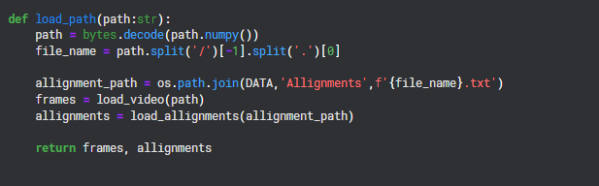
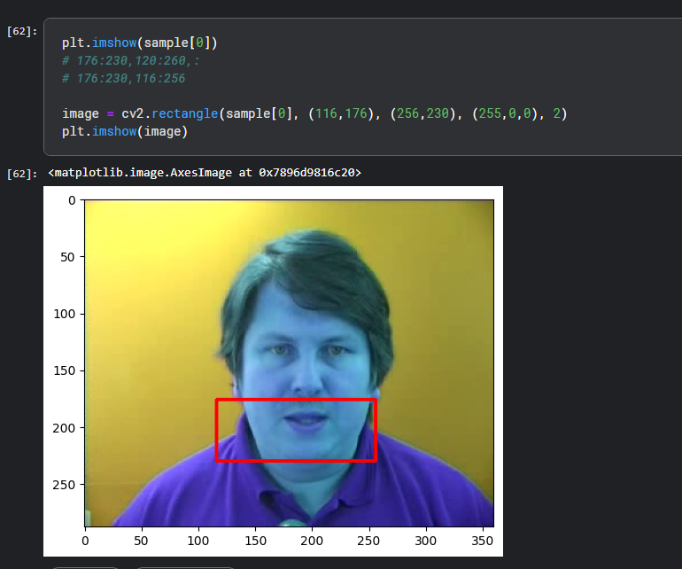

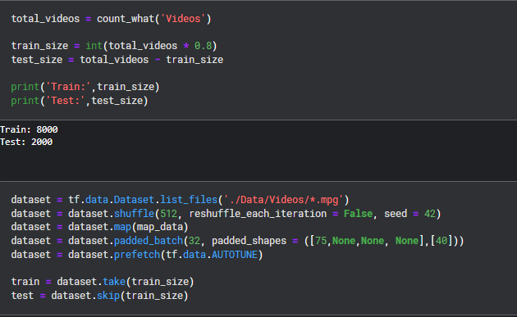
Implementation

Slide 13
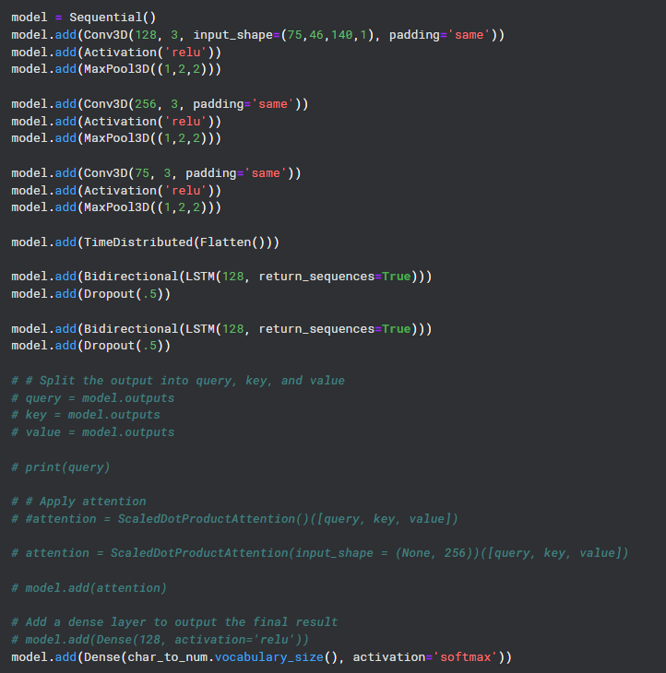
Implementation

Slide 14
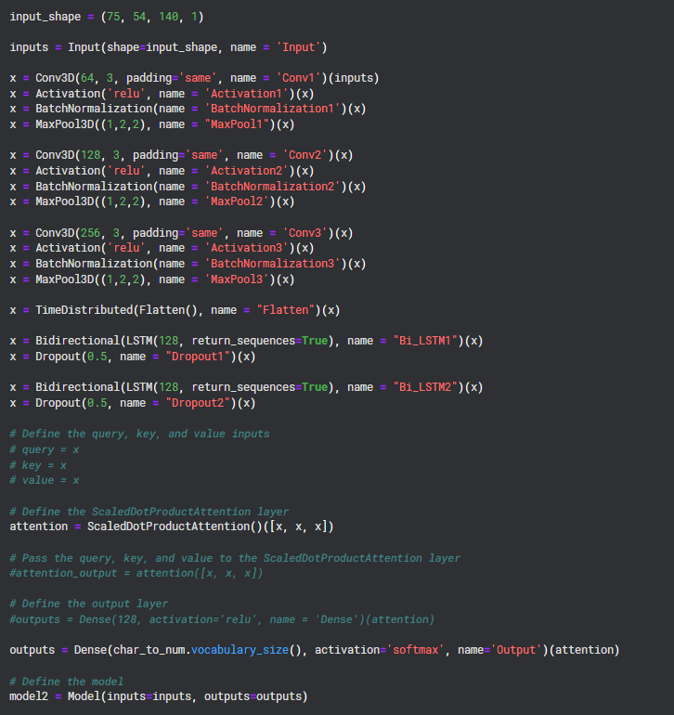
Implementation

Slide 15
Conclusion
We have made significant strides in our lip-reading project using deep learning, with data preprocessing and pipeline development successfully completed and a tentative model architecture established.
However, we are encountering some errors during the training phase, which highlights areas needing further refinement.
Addressing these issues will be our next focus, with efforts directed toward debugging and optimizing the model to enhance its performance.
Despite these challenges, the groundwork laid so far positions us well for advancing the project and achieving accurate visual speech recognition.

Slide 16
References
[1] Jeevakumar SA Amutha, and Koushik Dey. "LipSyncNet: A Novel Deep Learning Approach for Visual Speech Recognition in Audio-Challenged Situations." IEEE Access (2024).
[2] Fenghour, Souheil, Daqing Chen, Kun Guo, Bo Li, and Perry Xiao. "Deep learning-based automated lip-reading: A survey." IEEE Access 9 (2021): 121184-121205.
[3] Wang, Huijuan, Gangqiang Pu, and Tingyu Chen. "A lip reading method based on 3D convolutional vision transformer." IEEE Access 10 (2022): 77205-77212.
[4] Assael, Yannis M., Brendan Shillingford, Shimon Whiteson, and Nando De Freitas. "Lipnet: End-to-end sentence-level lipreading." arXiv preprint arXiv:1611.01599 (2016).
[5] Son Chung, Joon, Andrew Senior, Oriol Vinyals, and Andrew Zisserman. "Lip reading sentences in the wild." In Proceedings of the IEEE conference on computer vision and pattern recognition, pp. 6447-6456. 2017.

Slide 17
Thank You...!!

